Slide 1
Virtualization of CPU, Memory, and I/O Devices
Hardware Support for Virtualization
CPU Virtualization
Memory Virtualization
I/O Virtualization
Virtualization in Multi-Core Processors

Slide 2
Virtualization of CPU, Memory, and I/O Devices
To support virtualization, processors (such as x86)
- employ a special running mode and instructions,
- known as hardware-assisted virtualization.
In this way, VMM & guest OS run in different modes and
- all sensitive instructions of the guest OS & its applications
- are trapped in the VMM.
To save processor states, mode switching is completed by hardware.

Slide 3
Hardware Support for Virtualization
Modern operating systems and processors permit multiple processes to run simultaneously.
If there is no protection mechanism in a processor, all instructions from different processes will access the hardware directly and cause a system crash.
Therefore, all processors have at least two modes, user mode and supervisor mode, to ensure controlled access of critical hardware.
Instructions running in supervisor mode are called privileged instructions.
Other instructions are unprivileged instructions.
In a virtualized environment, it is more difficult to make OSes and applications run correctly because there are more layers in the machine stack.

Slide 4
Many hardware virtualization products were available (at the time of this writing).
The Vmware Workstation is a VM software suite for x86 and x86-64 computers.
This software suite allows users to set up multiple x86 and x86-64 virtual computers and to use one or more of these VMs simultaneously with the host operating system.
The VMware Workstation assumes the host-based virtualization.
Xen is a hypervisor for use in IA-32, x86-64, Itanium, and PowerPC 970 hosts.
KVM (linux kernel virtualization) can support hardware-assisted virtualization and paravirtualization by using the Intel VT-x or AMD-v and VirtIO framework, respectively.
The VirtIO framework includes a paravirtual Ethernet card, a disk I/O controller, a balloon device for adjusting guest memory usage, and a VGA graphics interface using VMware drivers.

Slide 5
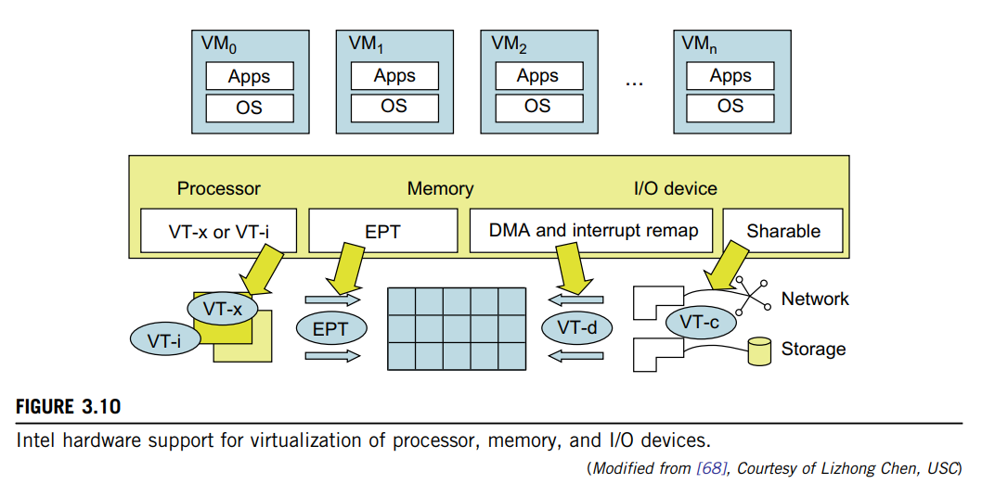
Ex: Hardware Support for Virtualization in the Intel x86 Processor
Note: EPT - translates the virtual address to the machine’s physical addresses to improve performance

Slide 6
CPU Virtualization
A VM is a duplicate of an existing computer system in which a majority of the VM instructions are executed on the host processor in native mode.
Thus, unprivileged instructions of VMs run directly on the host machine for higher efficiency.
Other critical instructions should be handled carefully for correctness and stability.
The critical instructions are divided into three categories:
1) Privileged instructions - execute in a privileged mode & will be trapped if executed outside this mode.
2) Control-sensitive instructions - attempt to change the configuration of resources used.
3) Behavior-sensitive instructions - have different behaviors
- depending on the configuration of resources,
- including the load & store operations over the virtual memory.

Slide 7
A CPU architecture is virtualizable
- if it supports the ability to run the VM’s privileged and unprivileged instructions in the CPU’s user mode
- while the VMM runs in supervisor mode.
When the privileged instructions including control- and behavior-sensitive instructions of a VM are executed, they are trapped in the VMM.
In this case, the VMM acts as a unified mediator for hardware access from different VMs to guarantee the correctness and stability of the whole system.
However, not all CPU architectures are virtualizable.
RISC CPU architectures can be naturally virtualized, on the contrary, x86 CPU architectures are not primarily designed to support virtualization.

Slide 8
Hardware-Assisted CPU Virtualization
This technique attempts to simplify virtualization because full or paravirtualization is complicated.
Intel and AMD add an additional mode called privilege mode level (some people call it Ring-1) to x86 processors.
Therefore, operating systems can still run at Ring 0 & hypervisor can run at Ring -1.
All the privileged and sensitive instructions are trapped in the hypervisor automatically.
This technique removes the difficulty of implementing binary translation of full virtualization.
It also lets the operating system run in VMs without modification.

Slide 9
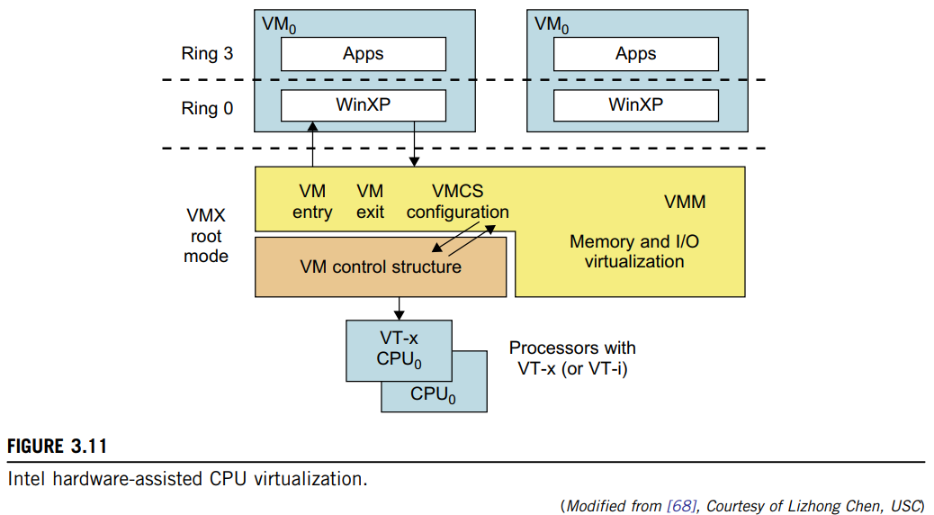
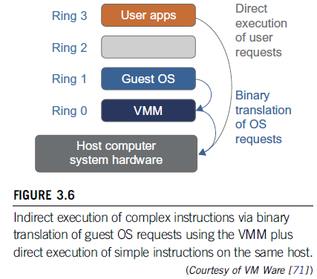
Ex: Intel Hardware-Assisted CPU Virtualization

Slide 10
Memory Virtualization
Virtual memory virtualization is similar to the virtual memory support provided by modern operating systems.
In a traditional execution environment, the operating system maintains mappings of virtual memory to machine memory using page tables, which is a one-stage mapping from virtual memory to machine memory.
All modern x86 CPUs include a memory management unit (MMU) and a translation lookaside buffer (TLB) to optimize virtual memory performance.
However, in a virtual execution environment, virtual memory virtualization involves sharing the physical system memory in RAM and dynamically allocating it to the physical memory of the VMs.
That means a two-stage mapping process should be maintained by the guest OS and the VMM, respectively:
virtual memory to physical memory and
physical memory to machine memory.

Slide 11
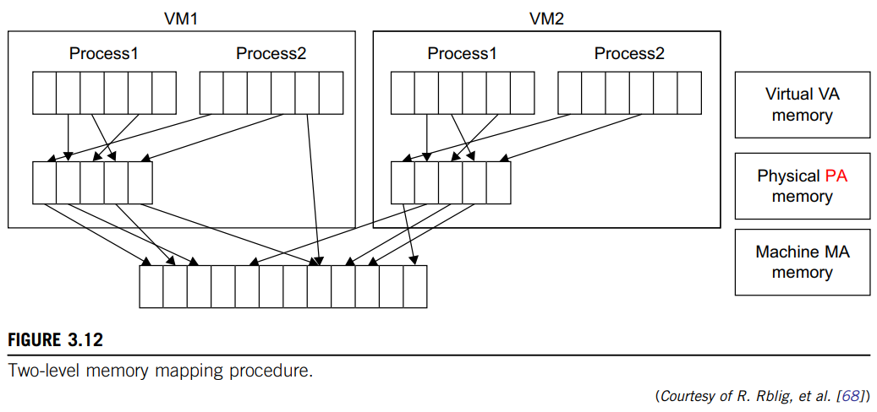
Furthermore, MMU virtualization should be supported, which is transparent to the guest OS.
The guest OS continues to control the mapping of virtual addresses to the physical memory addresses of VMs.
But the guest OS cannot directly access the actual machine memory.
The VMM is responsible for mapping the guest physical memory to the actual machine memory.
Figure 3.12 shows the two-level memory mapping procedure.

Slide 12
I/O Virtualization
I/O virtualization involves managing the routing of I/O requests between virtual devices & shared physical hardware.
Three ways to implement I/O virtualization are:
full device emulation,
para-virtualization, and
direct I/O.
Full device emulation:
First approach of I/O Virtualization, emulates well-known, real-world devices.
All the functions of a device or bus infrastructure, such as device enumeration, identification, interrupts, and DMA, are replicated in software.
This software is located in the VMM and acts as a virtual device.
The I/O access requests of the guest OS are trapped in the VMM which interacts with the I/O devices.
The full device emulation approach is shown in Figure 3.14.

Slide 13
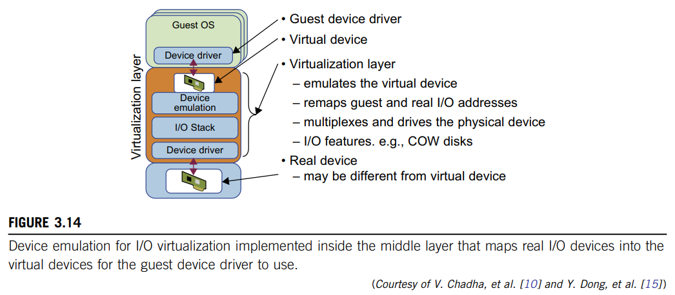

Slide 14
Para-virtualization method:
This I/O virtualization is typically used in Xen.
It is also known as the split driver model consisting of a frontend driver and a backend driver.
The frontend driver is running in Domain U &
backend driver is running in Domain 0.
They interact with each other via a block of shared memory.
Frontend driver - manages the I/O requests of the guest OSes
Backend driver - responsible for managing the real I/O devices & multiplexing the I/O data of different VMs.
Although para-I/O-virtualization achieves better device performance than full device emulation, it comes with a higher CPU overhead.

Slide 15
Direct I/O virtualization:
Lets the VM access devices directly.
It can achieve close-to-native performance without high CPU costs.
However, current direct I/O virtualization implementations focus on networking for mainframes.
There are a lot of challenges for commodity hardware devices.
For Ex, when a physical device is reclaimed (required by workload migration) for later reassignment, it may have been set to an arbitrary state (e.g., DMA to some arbitrary memory locations) that can function incorrectly or even crash the whole system.
Since software-based I/O virtualization requires a very high overhead of device emulation, hardware-assisted I/O virtualization is critical.
Intel VT-d supports the remapping of I/O DMA transfers and device-generated interrupts.

Slide 16
Virtualization in Multi-Core Processors
Virtualizing a multi-core processor is relatively more complicated than virtualizing a uni-core processor.
Though multicore processors are claimed to have higher performance by integrating multiple processor cores in a single chip.
Muti-core virtualization has raised some new challenges to computer architects, compiler constructors, system designers, and application programmers.
There are mainly two difficulties:
1) Application programs must be parallelized to use all cores fully, and
2) Software must explicitly assign tasks to the cores, which is a very
complex problem.
As technology scales, a new challenge called dynamic heterogeneity is emerging to mix the fat CPU core and thin GPU cores on the same chip, which further complicates the multi-core or many-core resource management.

Slide 17
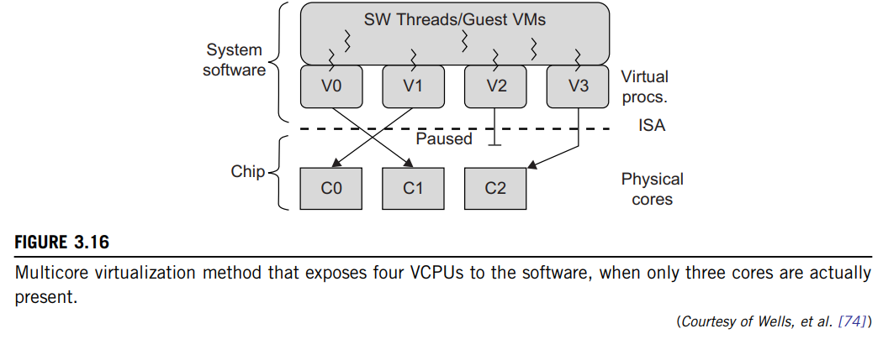
Physical versus Virtual Processor Cores
A multicore virtualization method was proposed to allow hardware designers to get an abstraction of low-level details of the processor cores.
This technique alleviates the burden & inefficiency of managing hardware resources by software.
It is located under the ISA and remains unmodified by the operating system or VMM (hypervisor).
Figure 3.16 illustrates the technique of a software-visible VCPU moving from one core to another and temporarily suspending execution of a VCPU when there are no appropriate cores on which it can run.

Slide 18
Virtual Hierarchy
The emerging many-core chip multiprocessors (CMPs) provides a new computing landscape.
Instead of supporting time-sharing jobs on one or a few cores, we can use the abundant cores in a space-sharing, where single-threaded or multithreaded jobs are simultaneously assigned to separate groups of cores for long time intervals.
To optimize for space-shared workloads, they propose using virtual hierarchies to overlay a coherence and caching hierarchy onto a physical processor.
Unlike a fixed physical hierarchy, a virtual hierarchy can adapt to fit how the work is space shared for improved performance & performance isolation.

Slide 19
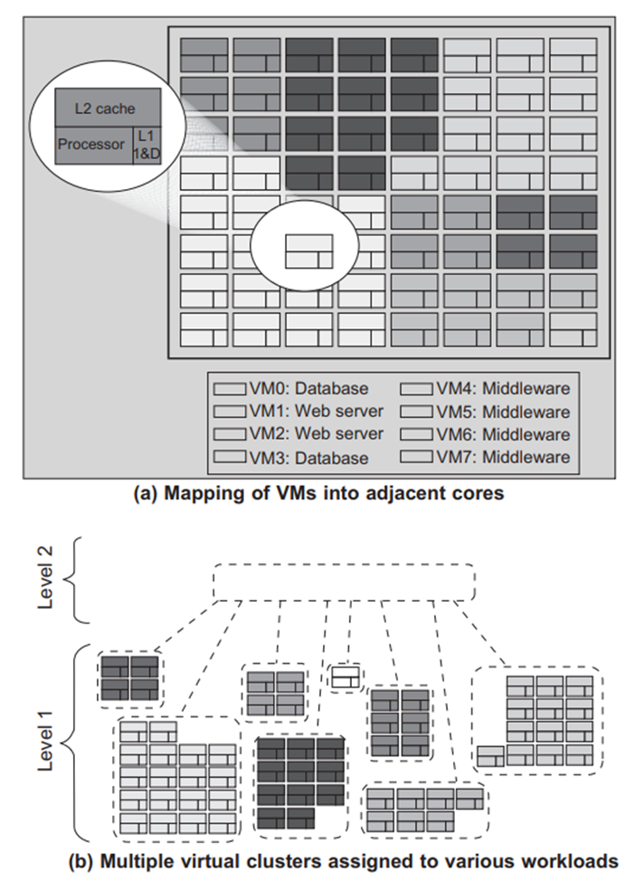
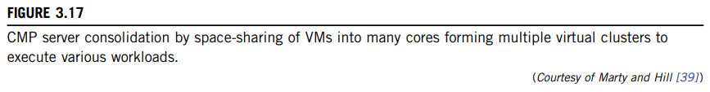
The idea is illustrated in Figure 3.17(a).
Space sharing is applied to assign three workloads to three clusters of virtual cores: namely VM0 and VM3 for database workload, VM1 and VM2 for web server workload, and VM4–VM7 for middleware workload.
The basic assumption is that each workload runs in its own VM.
However, space sharing applies equally within a single operating system.

Slide 20
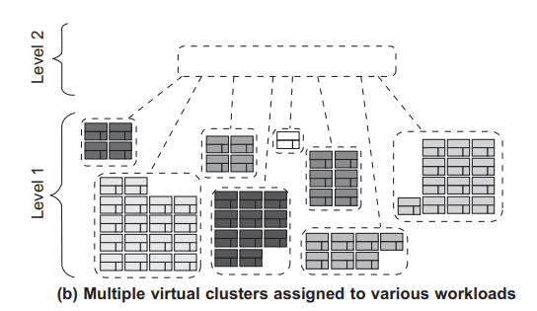
Marty and Hill suggested a two-level virtual coherence and caching hierarchy.
Figure 3.17(b) illustrates a logical view of such a virtual cluster hierarchy.
Each VM operates in a isolated fashion at the first level.
- This will minimize both miss access time & performance interference with other workloads or VMs.
The second level maintains a globally shared memory.
- facilitates dynamically repartitioning resources without costly cache flushes.
Furthermore, maintaining globally shared memory minimizes changes to existing system software and allows virtualization features such as content-based page sharing.

